Slide 1
Radiomics-Based Machine Learning Framework for Pulmonary Nodule Malignancy Classification Using Computed Tomography Images
Aman Chaudhary
MSc. Computer Science | Department of Computer Science
2026 MAA Conference | Columbia, MO
Notes:
monste

Slide 2
Outline:
Introduction
Methods
Results
Conclusions
References

Slide 3
Introduction:
Lung cancer is a leading cause of cancer-related death.
Accurate classification of lung nodules malignancy (LNM) is critical for early diagnosis.
Radiomics-based machine learning has shown promise for nodule classification.
Many prior studies rely on complex “black-box” models.
Black-box models may not perform reliably on imbalanced clinical datasets.
This study evaluates whether classical machine learning models can reliably predict LNM.

Slide 4
Introduction Cont.
Propose of Study:
To evaluate the reliability of classical machine learning methods for radiomics-based classification of LNM.

Slide 5
Introduction Cont.
Research Question:
What is the optimal Machine Learning (ML) method for classifying LNM using radiomics features?

Slide 6
Introduction Cont.
Research Objectives:
Segment pulmonary nodules from CT images
Extract radiomics features
Apply multi-stage feature selection
Train classical machine learning models
Handle class imbalance using appropriate metrics
Evaluate performance on test data

Slide 7
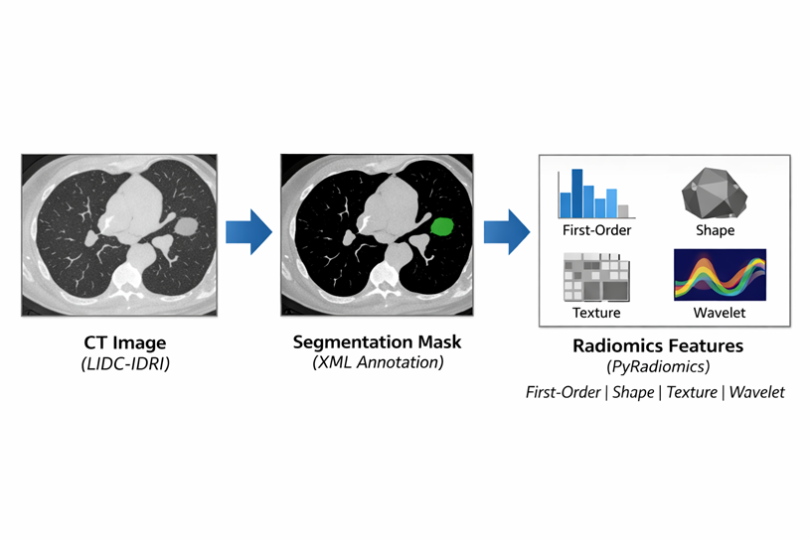
Methods :
Sample:
1012 cancer patients CT Scan Images (LIDC IDRI).
Features extracted
Notes:
CT images were obtained from the LIDC-IDRI dataset, which contains pulmonary nodule annotations provided by multiple radiologists. Each nodule includes a malignancy score used to define the classification label.

Slide 8
Methods Cont.
Variables:
1437 variables were studied.
Response variable:
Label: 1 means malignant; 0 means benign.
Label implies patients with malignancy score greater than 3.
Predictors:
Texture Features; Shape Features; Coarseness; First Order Features.
Notes:
CT images were obtained from the LIDC-IDRI dataset, which contains pulmonary nodule annotations provided by multiple radiologists. Each nodule includes a malignancy score used to define the classification label.

Slide 9
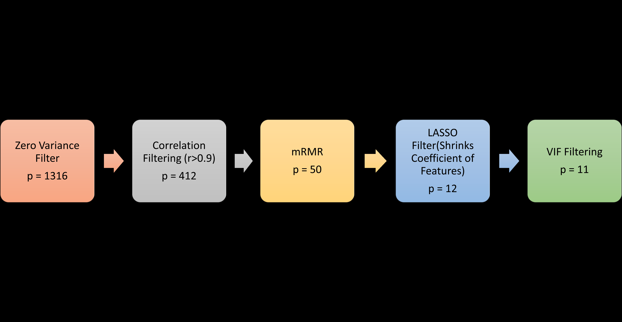
Methods Cont.
Statistical Analysis:
Data Preprocessing and Cleaning.
Removal of redundant information; Data Imputation.
Data Partitions:
Train : 80%, Test: 20%
Variable Selection:
Notes:
CT images were obtained from the LIDC-IDRI dataset, which contains pulmonary nodule annotations provided by multiple radiologists. Each nodule includes a malignancy score used to define the classification label.

Slide 10
Methods Cont.
Statistical Analysis:
Exploratory Data Analysis:
Heatmap; Boxplot; Scatterplot.
Statistical and Machine Learning Methods:
Binary Logistic Regression (LR); XGBoost (XgB); Random Forest (RF).
Notes:
To evaluate the proposed radiomics-based classification approach, multiple machine learning models were selected as baseline classifiers. These models were chosen to compare interpretable linear methods with nonlinear and ensemble methods that are commonly used in radiomics studies.

Slide 11
Methods Cont.
Statistical Analysis:
Model Evaluation Metrics:
Confusion Matrix
Precision
Recall
F-1 Score
Precision Recall – Area Under the Curve (PR-AUC)
Notes:
To evaluate the proposed radiomics-based classification approach, multiple machine learning models were selected as baseline classifiers. These models were chosen to compare interpretable linear methods with nonlinear and ensemble methods that are commonly used in radiomics studies.

Slide 12
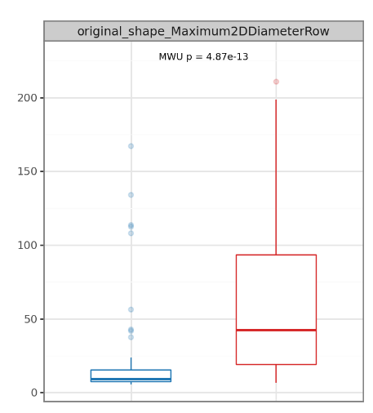
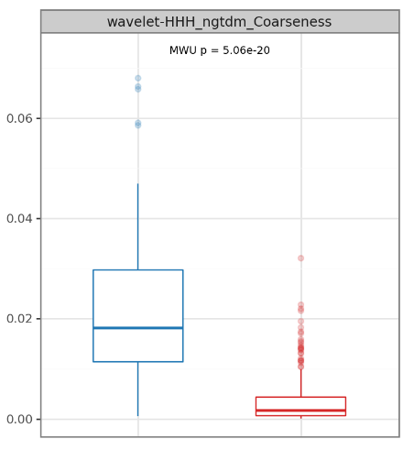
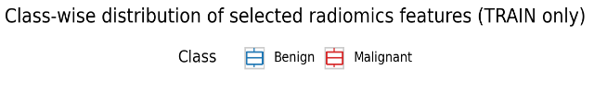
Results:
Fig 1:

Slide 13
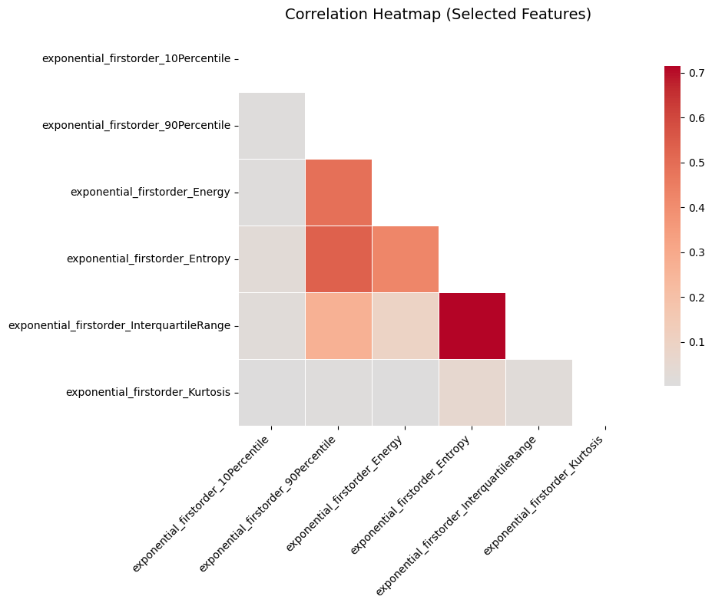
Results Cont.
Fig 2: Correlation Heatmap

Slide 14
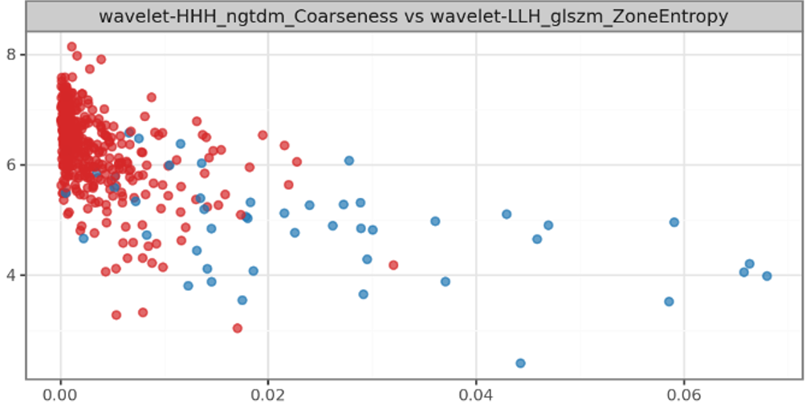
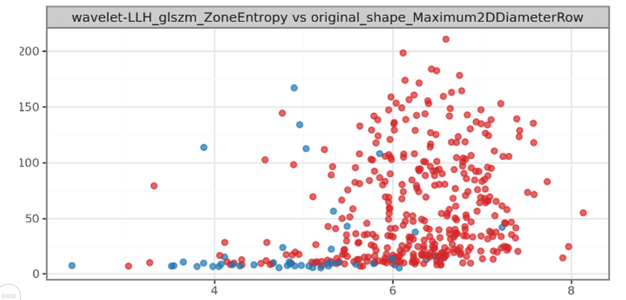

Results(EDA):
Fig 3:
Notes:
To evaluate the proposed radiomics-based classification approach, multiple machine learning models were selected as baseline classifiers. These models were chosen to compare interpretable linear methods with nonlinear and ensemble methods that are commonly used in radiomics studies.

Slide 15
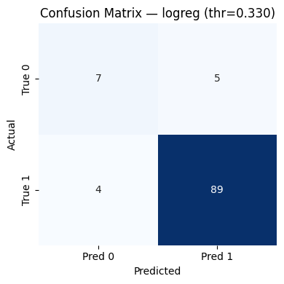
Results Cont.
Fig 4: Confusion Matrix of LR
Notes:
On the training set, Random Forest and XGBoost achieved AUC close to 1.0, while logistic regression showed slightly lower but still high performance. On the test set, AUC decreased for all models, indicating expected reduction in performance when evaluated on unseen data. Random Forest achieved the highest ROC-AUC (~0.88), followed by XGBoost (~0.84), and logistic regression (~0.75). Despite the decrease, all models performed above chance level, confirming predictive ability.

Slide 16
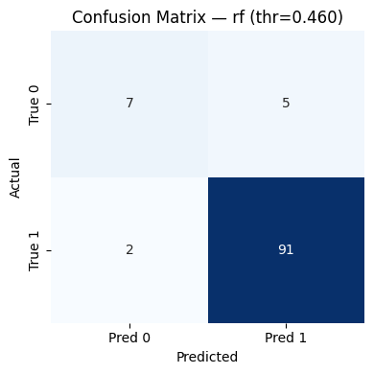
Results Cont.
Fig 5: Confusion Matrix of RF
Notes:
On the training set, Random Forest and XGBoost achieved AUC close to 1.0, while logistic regression showed slightly lower but still high performance. On the test set, AUC decreased for all models, indicating expected reduction in performance when evaluated on unseen data. Random Forest achieved the highest ROC-AUC (~0.88), followed by XGBoost (~0.84), and logistic regression (~0.75). Despite the decrease, all models performed above chance level, confirming predictive ability.

Slide 17
Results Cont.
Metric | Logistic Regression | XGBoost | Random Forest
ROC-AUC | 0.81 | 0.86 | 0.90
PR-AUC | 0.94 | 0.98 | 0.98
Precision | 0.94 | 0.94 | 0.94
Recall | 0.95 | 0.95 | 0.97
F1 Score | 0.95 | 0.95 | 0.96
Table 1: Evaluation Metric For Each Model (Test result)

Slide 18
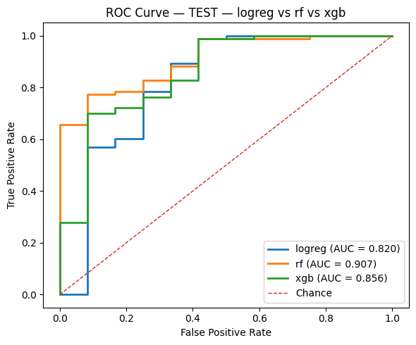
Results Cont.
Fig 6: ROC Curve for Each Model
Notes:
On the training set, Random Forest and XGBoost achieved AUC close to 1.0, while logistic regression showed slightly lower but still high performance. On the test set, AUC decreased for all models, indicating expected reduction in performance when evaluated on unseen data. Random Forest achieved the highest ROC-AUC (~0.88), followed by XGBoost (~0.84), and logistic regression (~0.75). Despite the decrease, all models performed above chance level, confirming predictive ability.

Slide 19
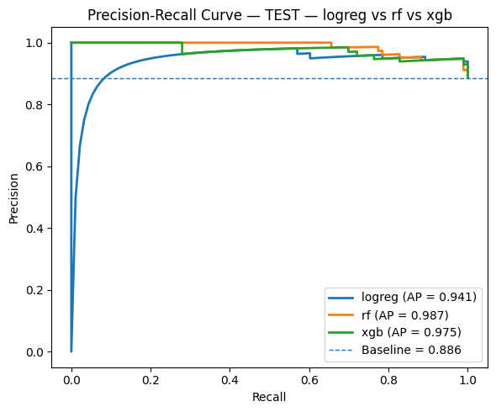
Results Cont.
Fig 7: AUC for Each Model
Notes:
On the training set, all models achieved near-perfect PR performance, with PR-AUC close to 1.0, indicating strong learning of radiomics features. On the test set, Random Forest and XGBoost maintained high PR-AUC (≈0.98 and 0.97), while logistic regression showed slightly lower performance (≈0.92). All models remained well above the baseline precision, confirming that the models perform better than random classification. High PR-AUC indicates good performance under class imbalance, which is important because malignant cases dominate the dataset.

Slide 20
Conclusions:
Random Forest was found to be the best ML method for classifying LNM using radiomics features based on Recall and F1-score.
The findings show that radiomics-based predictive models can achieve high diagnostic accuracy for LNM classification and may serve as critical predictive tools for supporting clinical decision.
Notes:
What is the optimal Machine Learning (ML) method for classifying LNM using radiomics features?

Slide 21
Future Work:
Evaluate additional ML methods such as SVM, LDA, Naive Bayes, KNN, Gradient Boosting, etc.
Introduce External Dataset Validation
To address imbalance class, future research will compare sampling methods including RandomOverSample, undersampling, etc.
To create interpretable models.

Slide 22
References:
[1] Armato, S. G., McLennan, G., Bidaut, L., McNitt-Gray, M. F., Meyer, C. R., Reeves, A. P., Zhao, B., et al. (2011). The Lung Image Database Consortium (LIDC) and Image Database Resource Initiative (IDRI): A Completed Reference Database of Lung Nodules on CT Scans. Medical Physics, 38(2), 915–931.
[2] van Griethuysen, J. J. M., Fedorov, A., Parmar, C., Hosny, A., Aucoin, N., Narayan, V., Beets-Tan, R. G. H., et al. (2017). Computational Radiomics System to Decode the Radiographic Phenotype. Cancer Research, 77(21), e104–e107.
[3] Zwanenburg, A., Vallières, M., Abdalah, M. A., Aerts, H. J. W. L., Andrearczyk, V., Apte, A., Ashrafinia, S., et al. (2020). The Image Biomarker Standardisation Initiative: Standardized Quantitative Radiomics for High-Throughput Image-based Phenotyping. Radiology, 295(2), 328–338.
[4] Peng, H., Long, F., & Ding, C. (2005). Feature Selection Based on Mutual Information: Criteria of Max-Dependency, Max-Relevance, and Min-Redundancy. IEEE Transactions on Pattern Analysis and Machine Intelligence, 27(8), 1226–1238.

Slide 23
Acknowledgements
Faculty Advisor:
Dr. Mohamed Abu Sheha
Assistant Professor of Statistics
Department of Mathematics
Southeast Missouri State University
Email: mabusheha@semo.edu
Faculty Advisor:
Dr. Emmanuel Thompson
Professor of Actuarial Science & Statistics
Department of Mathematics
Southeast Missouri State University
Email: ethompson@semo.edu

Slide 24
Questions / Suggestions :

